Slide 1
Employee Data Analysis using Excel
STUDENT NAME: Gunal .V
REGISTER NO: 312203429
DEPARTMENT: MANAGEMENT
COLLEGE : HINDUSTAN COLLEGE OF ARTS & SCIENCE

Slide 2
PROJECT TITLE
Employee Performance Analysis using Excel

Slide 3


AGENDA
Problem Statement
Project Overview
End Users
Our Solution and Proposition
Dataset Description
Modelling Approach
Results and Discussion
Conclusion
3/21/2024 Annual Review

Slide 4

PROBLEM STATEMENT
• This PowerPoint is about the performance
analysis of the employees in a company
during a particular period.
• The performance analysis is use to know
about the work of an employee.
• By doing this we can easily identify the best
employees of the company.

Slide 5

PROJECT OVERVIEW
• Employee performance analysis is the process of
evaluating how well employees perform their job
duties and responsibilities. This involves assessing
various aspects of their work, including
productivity, quality, and efficiency, as well as their
contribution to organizational goals.
• In this project the performance is analyzed by using
the employee’s gender, business unit, performance
category, first name, last name, date of birth,
performance rating and with 20 more columns

Slide 6

WHO ARE THE END USERS?
The end users of the employee performance
analysis are:
• Employee
• Employer
• Manager
• Supervisors
• HR
• Executives
• Senior leadership
• Financial analyst
• Training and development teams

Slide 7

OUR SOLUTION AND ITS VALUE PROPOSITION
USED FORMULAS AND TECHIQUES
OUR SOLUTION AND ITS VALUE PROPOSITION
• Conditional formatting to find the blank
cells.
• Filter option to eliminate the blank cells in
the columns.
• IFS formula to convert the performance
rating to text.
• Pivot table to make a summary about the
project.
• Chart visualization for easy understanding
of the analysis

Slide 8
Dataset Description
Dataset Description
DETAILS OF THE DATASET:
• Downloaded the dataset from the Edunet student
dashboard.
• It contains totally 26 features.
• In this project I have selected 9 features to analyse the
performance.
• Employee ID and the current employee rating are in
numerical values.
• I have added one more feature called performance
category to convert the rating into text by formula

Slide 9

THE "WOW" IN OUR SOLUTION
3/21/2024 Annual Review
THE "WOW" IN OUR SOLUTION
❑ The main thing of the project is converting the rating
into text by using IFS formula:
• =IFS(Z8>=5,“AVERAGE",Z8>=4,“BAD",Z8>=3,"GOOD",TRUE,“VERYBAD")
❑ The second part is about the
Pivot table used in the excel
to easily identify the
performance based on the
employee work type:
3/21/2024 Annual Review
‹#›

Slide 10
MODELLING
❑ Data collection:
The employee dataset is collected from the Edunet dashboard.
❑ Features collection:
Then, the features for the project is selected from the dataset.
❑ Conversion:
Then, the rating is converted into text by using formula.
❑ Creation of Pivot table:
Then, created a pivot table using the insert tool.
➢ Where,
1. The business unit is used in the rows.
2. The gender code is used as filter.
3. The performance category is used as the values.
4. The employee classification type is used in columns.
❑ Creation of chart:
The chart is created by using the insert tool.
➢ Where,
1. Number of employees are in the Y axis and the business unit in the X axis. T
‹#›

Slide 11
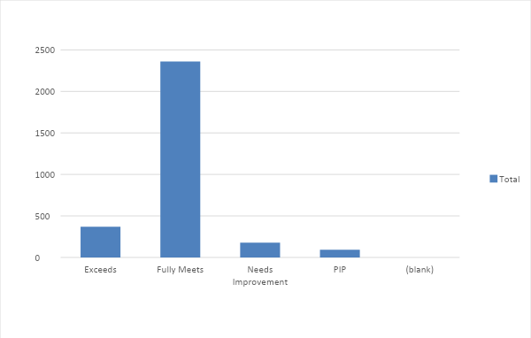
RESULTS
CHART FOR FEMALE EMPLOYEE PERFORMANCE ANALYSIS:
‹#›

Slide 12
conclusion
❑The conclusion of female employee analysis is that the
temporary type employees are performing more than
the other employees.
❑It shows that the number of employees in the full time
job is between 18 and 36.
❑The number of employees in the part time job is
between 19 and 38.
❑Lastly the number of employees in the temporary job is
23 and 40.
❑Therefore, the company may prefer temporary job
persons more than others to get a good outcome.

